Slide 1


Slide 2

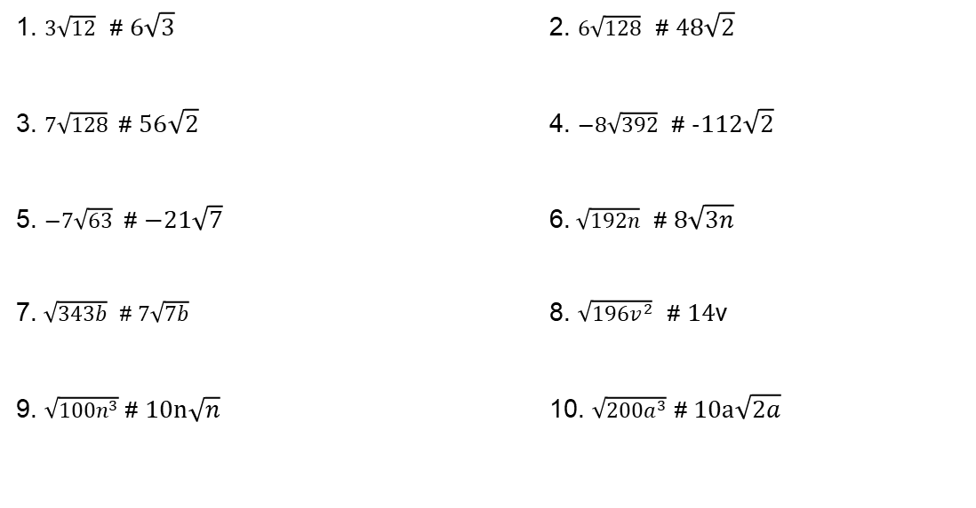
Radicals – exercises
1. $3\sqrt{12}$ # $6\sqrt{3}$ 2. $6\sqrt{128}$ # $48\sqrt{2}$
3. $7\sqrt{128}$ # $56\sqrt{2}$ 4. $−8\sqrt{392}$ # $−112\sqrt{2}$
5. $−7\sqrt{63}$ # $−21\sqrt{7}$ 6.$\sqrt{192n}$ # $8\sqrt{3n}$
7. $\sqrt{343b}$ # $7\sqrt{7b}$ 8. $\sqrt{196v^{2}}$ # $14$v
9. $\sqrt{100n^{3}}$ # $10n\sqrt{n}$ 10. $\sqrt{200a^{3}}$ # $10a\sqrt{2a}$

Slide 3
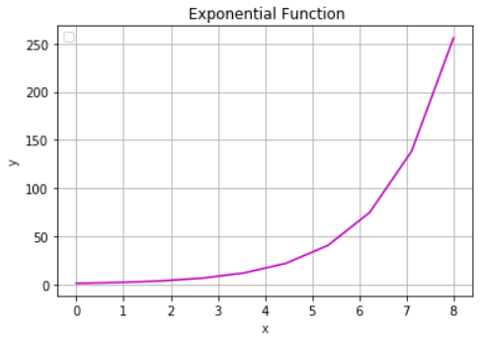
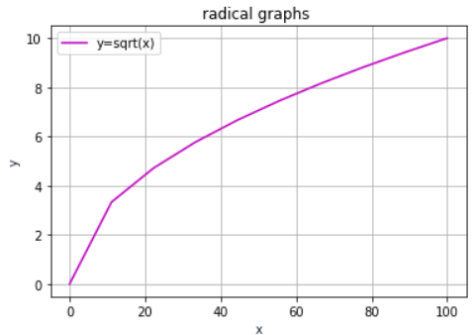
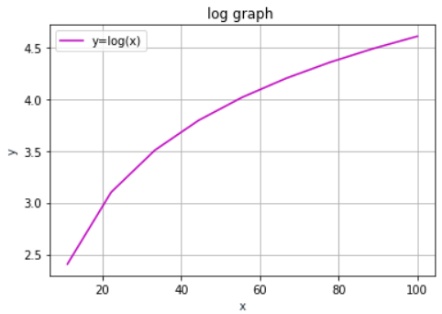
Exponents, logarithms and radicals
x = np.linspace(0,8,10)
y1 = 2**x -3
plt.plot(x, y1, ‘-m’)
plt.show()
x = np.linspace(0,100,10)
y1 = np.sqrt(x)
plt.plot(x, y1,'-m', label='y=sqrt(x)')
plt.show()
x = np.linspace(0,100,10)
y1 = np.log(x)
plt.plot(x, y1,'-m', label='y=log(x)’)
plt.show()

Slide 4
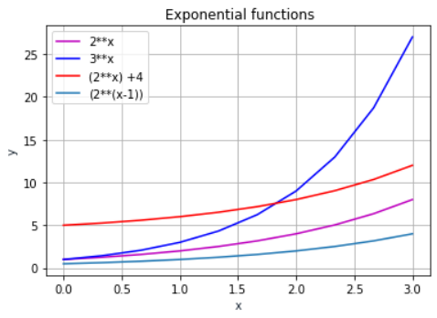
import matplotlib.pyplot as plt
import numpy as np
x = np.linspace(0,3,10)
y1 = 2**x
y2 = 3**x
y3 = (2**x) +4
y4 = (2**(x-1))
plt.plot(x,y1, 'm', label= '2**x')
plt.plot(x, y2, '-b', label= '3**x')
plt.plot(x, y3, '-r', label= '(2**x) +4')
plt.plot(x, y4, label= '(2**(x-1))')
plt.title(‘ Exponential function')
plt.xlabel('x')
plt.ylabel('y')
plt.legend(loc='upper left')
plt.grid()
plt.show()
Multiple functions for comparisons

Slide 5

<WELCOME >
<Trigonometry>

Slide 6
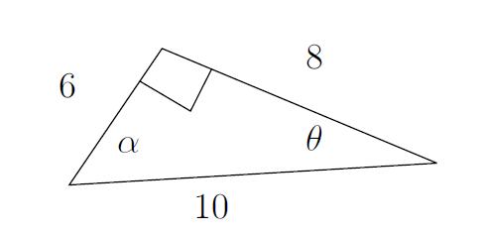
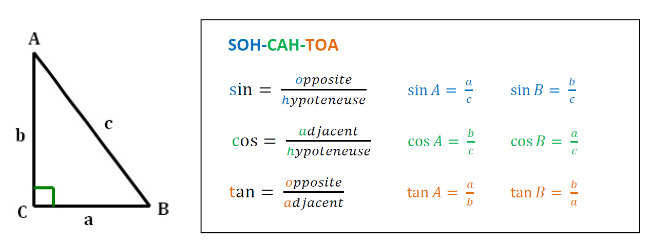
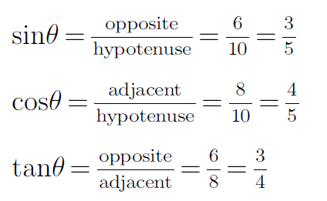
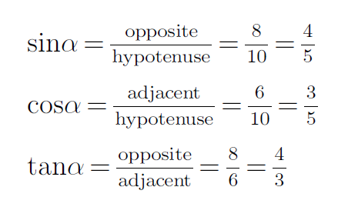
Trigonometric

Slide 7
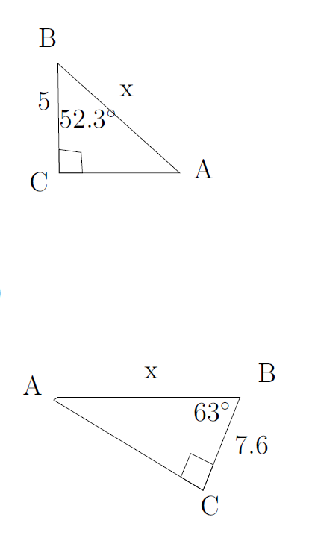
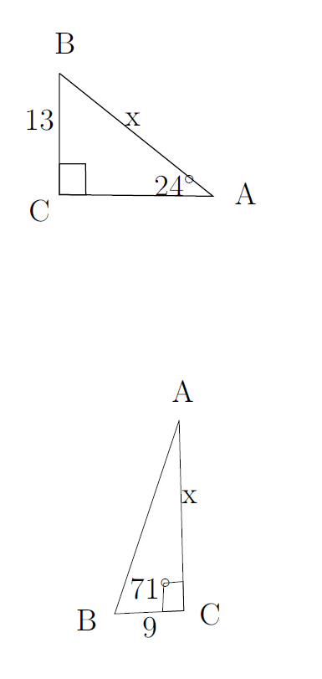
Trigonometry – examples

Slide 8
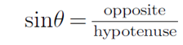
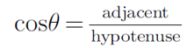
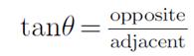
Trigonometry – examples
#31.96
#8.17
#26.1
#16.7

Slide 9
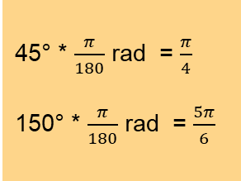
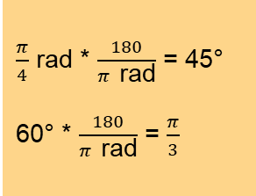
Radians and Degrees
Degrees to radians
360°= 2π radians
180°= π radians
Examples
Radians to degrees
360°= 2π radians
180°= π radians
Examples
d
r
d
45° * $\frac{π}{180}$ rad = $\frac{π}{4}$
150° * $\frac{π}{180}$ rad = $\frac{5π}{6}$
$\frac{π}{4}$ rad * $\frac{180}{π \text{rad}}$ = 45°
60° * $\frac{180}{π \text{rad}}$ = $\frac{π}{3}$
Observer’s perspective
Driver’s perspective

Slide 10
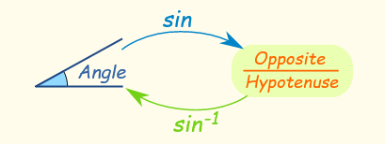
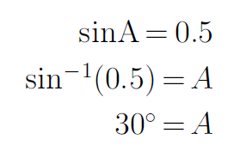
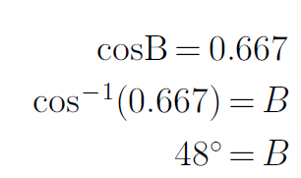
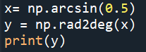
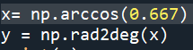
Trigonometric

Slide 11
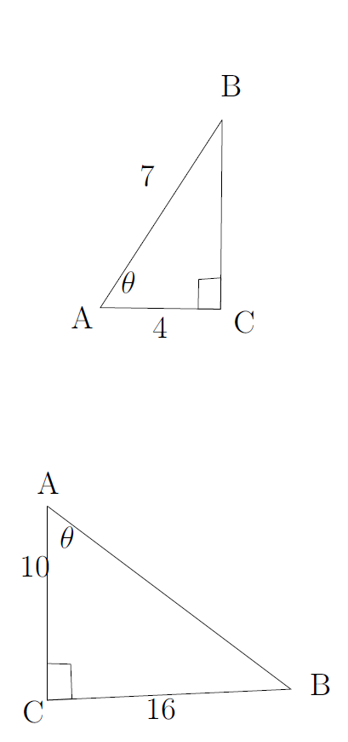
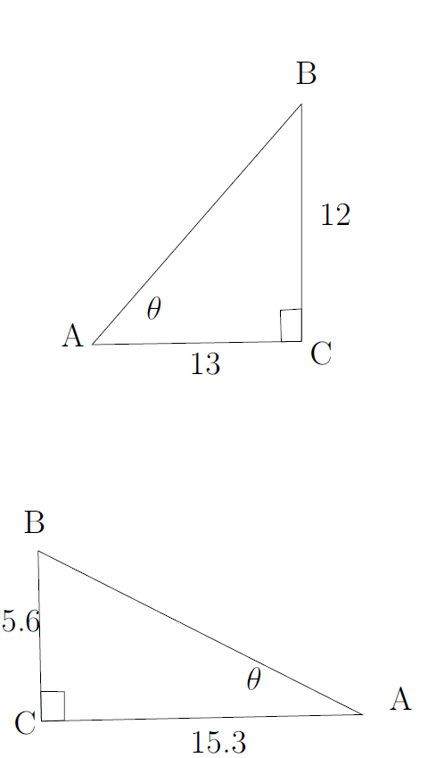
Exercises

Slide 12
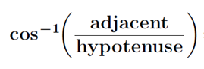
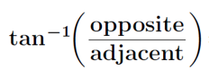
Exercises
#55.2
#42.7
#57.99
#20.1

Slide 13
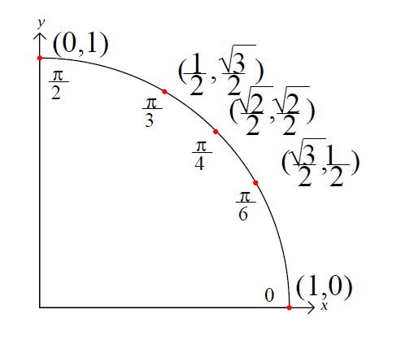
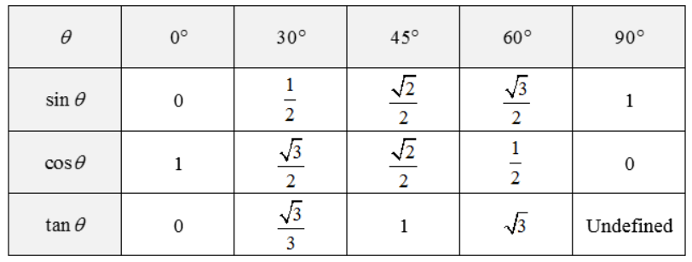
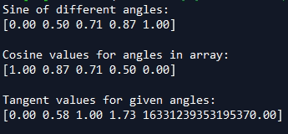
Most used angles in math located in the first quadrant
import numpy as np
numpy.set_printoptions(precision=2)
numpy.set_printoptions(formatter={"float":'{:0.2f}'.format})
a = np.array([0,30,45,60,90])
print('Sine of different angles:')
# Convert to radians by multiplying to pi/180
print(np.sin(a*np.pi/180), "\n")
print("Cosine values for angles in array:")
print(np.cos(a*np.pi/180), "\n")
print('Tangent values for given angles:')
print(np.tan(a*np.pi/180))

Slide 14
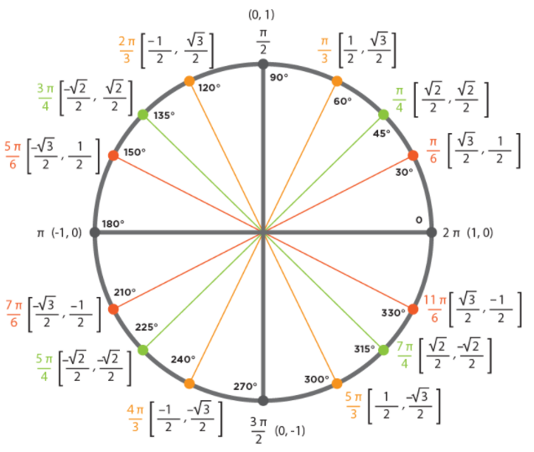
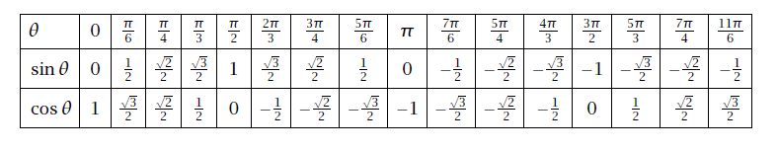
Trigonometric relation in the circle

Slide 15
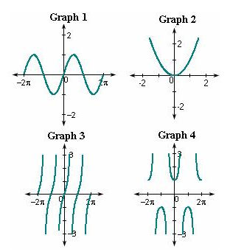
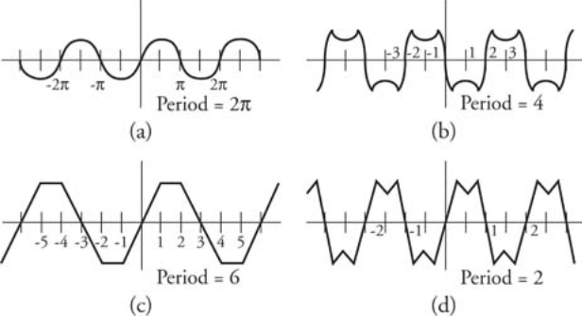
Periodic functions definition
A periodic function occurs when a specific horizontal shift, P, results in the original
function; where f (x + P) = f (x) for all values of x. When this occurs we call the
horizontal shift the period of the function.

Slide 16
Periodic functions definition
A periodic function occurs when a specific horizontal shift, P, results in the original
function; where f (x + P) = f (x) for all values of x. When this occurs we call the
horizontal shift the period of the function.

Slide 17
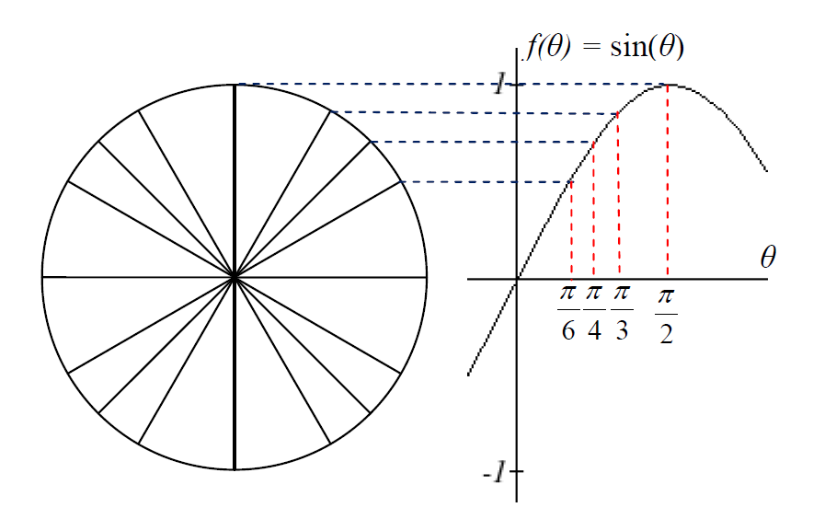
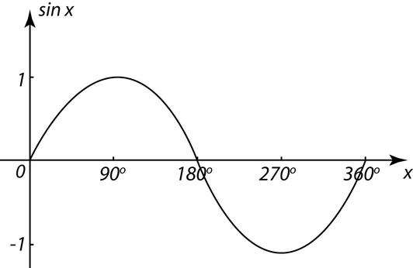
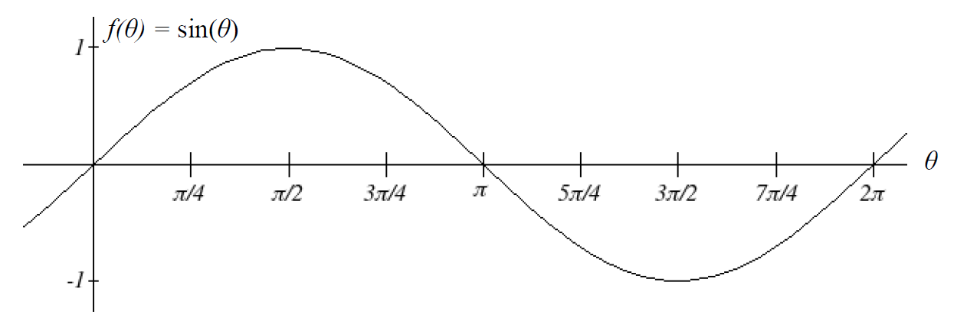
Periodic functions
radians representation
Degrees representation

Slide 18
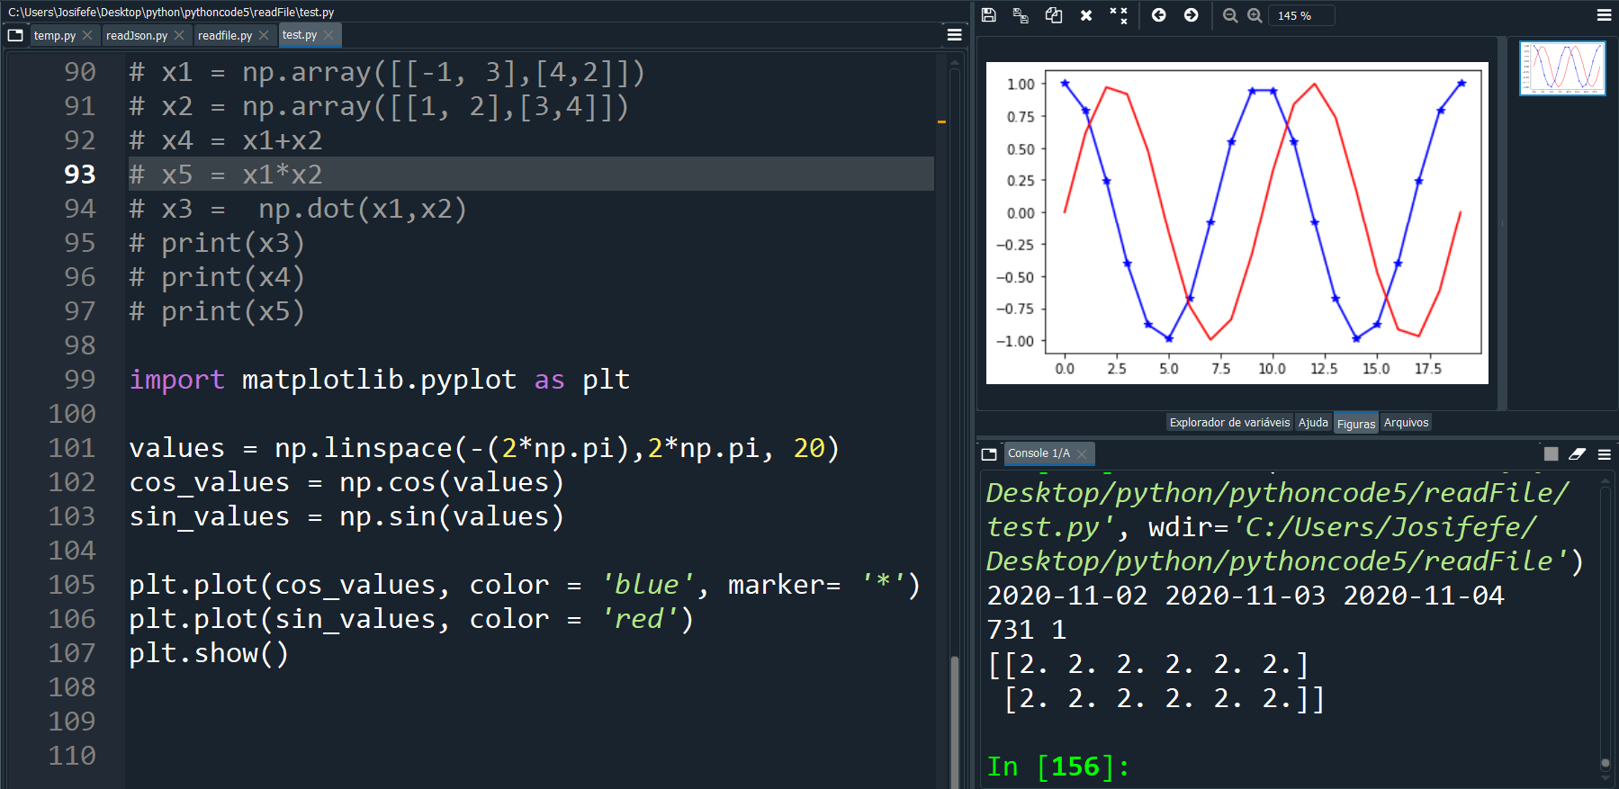

Slide 19
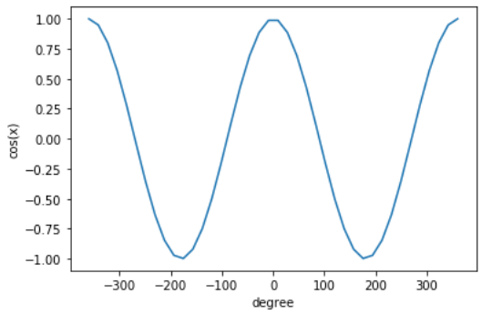
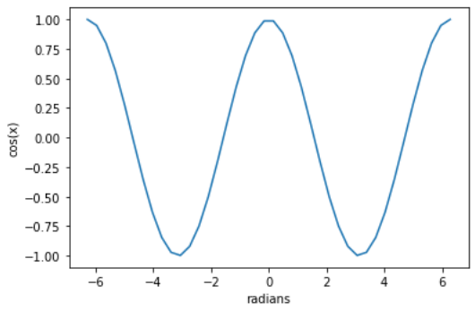
cos (x) in degrees
import numpy as np
import matplotlib.pyplot as plt
x = np.linspace(-2*np.pi, 2*np.pi, 40)
x1 = np.rad2deg(x)
y = np.cos(x)
plt.plot(x1,y)
plt.xlabel('degree')
plt.ylabel('cos(x)')
cos (x) in radians
import numpy as np
import matplotlib.pyplot as plt
x = np.linspace(-2*np.pi, 2*np.pi, 40)
y = np.cos(x)
plt.plot(x,y)
plt.xlabel('radians')
plt.ylabel('cos(x)')

Slide 20
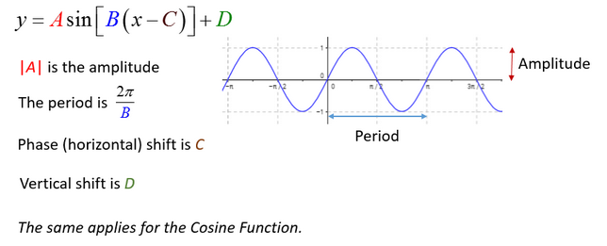
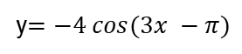
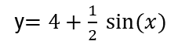
Periodic functions
Amplitude
Period
Phase shift
y$=4+\frac{1}{2} sin⁡(x)$
y$=−4 cos(3x −π)$

Slide 21
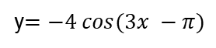
Periodic functions – exercises spyder
y$=4+\frac{1}{2} sin⁡(x)$
Radians degrees samples
y$=−4 cos(3x −π)$
What is the period of these functions?
What is the amplitude?
How many samples (minimum amount ) is needed to see the smoothing charts ?

Slide 22
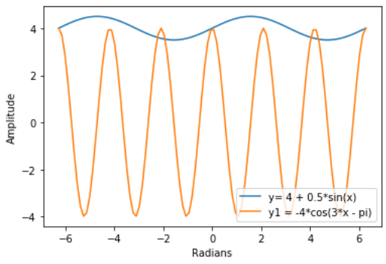
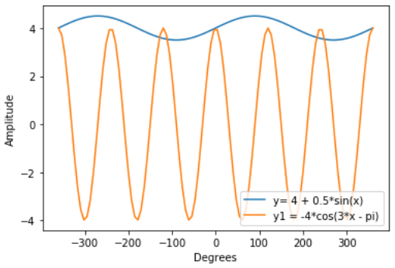
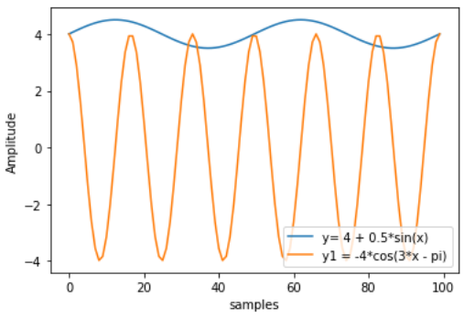
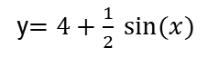
Periodic functions – exercises spyder
Radians degrees
y$=4+\frac{1}{2} sin⁡(x)$
y$=−4 cos(3x −π)$
Samples

Slide 23
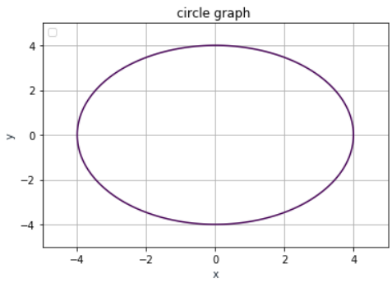
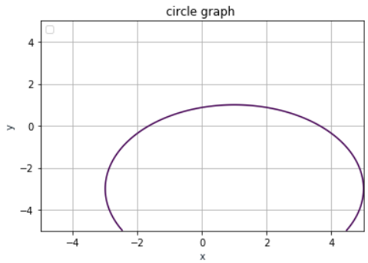
What is not a function ?
import matplotlib.pyplot as plt
import numpy as np
x = np.linspace(-5,5,100)
y = np.linspace(-5,5,100)
X, Y = np.meshgrid(x,y)
f = X**2+Y**2 -16
fig, ax = plt.subplots()
ax.contour(X,Y,f,[0])
plt.title('circle graph ')
plt.xlabel('x', color='#1C2836')
plt.ylabel('y', color='#1C2833')
plt.legend(loc='upper left')
plt.grid()
plt.show()
Circle equation
X^2 +Y^2 = 16
(X-1)**2+(Y+3)**2 =16

Slide 24
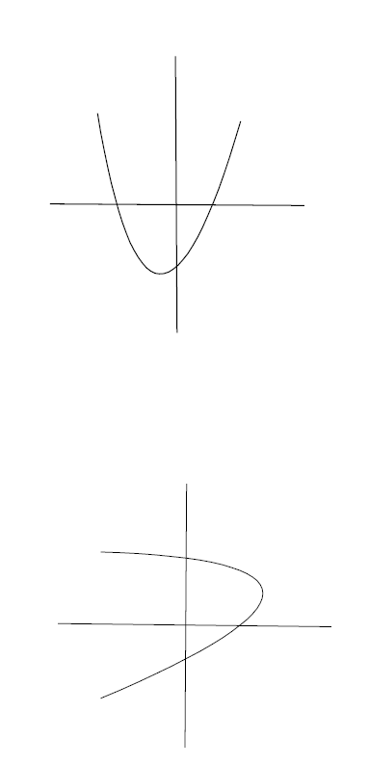
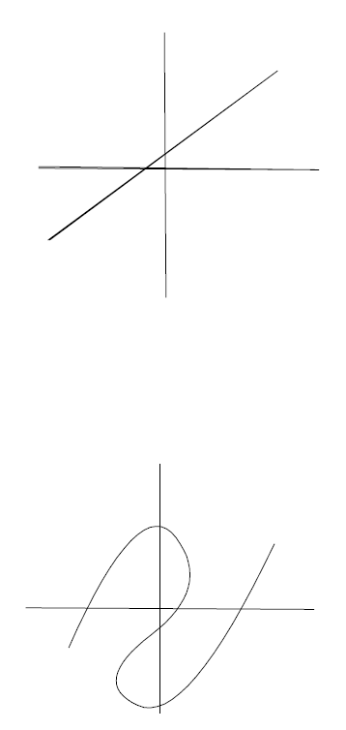
What are functions here ?
a)
c)
b)
d)

Slide 25
What are functions here ?
a)
c)
Function
Function
b)
d)
Non-Function
Non-Function

Slide 26
https://www.smashingmagazine.com/2010/02/applying-mathematics-to-web-design/

Slide 27
Make it work
Make it Right
Make it Fast

Slide 28


